Slide 1
Electro workshop 3 https://x.valky.eu/elec3
Ing. Gabriel Valky, PhD.

Slide 2


5V
ATMEGA328P
0V

Slide 3

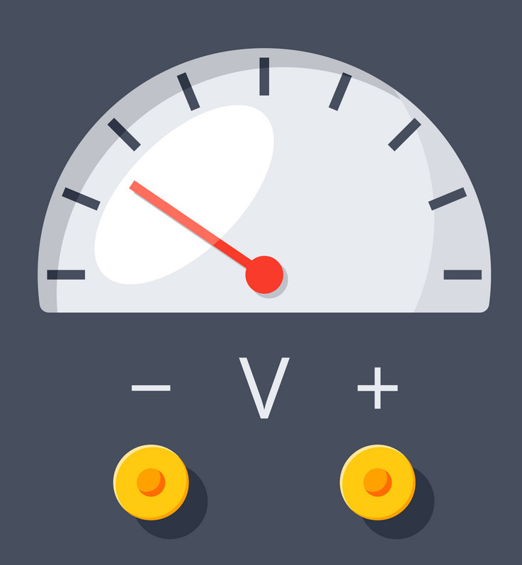
ATMEGA328P

Slide 4

5V
ATMEGA328P

Slide 5

Experiment – vstupna impedancia

Slide 7
Letujeme

Slide 8
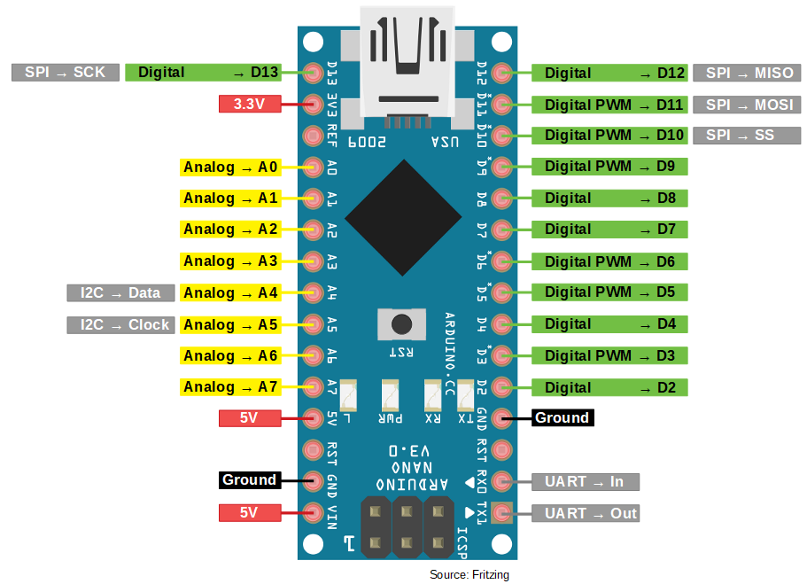

Slide 9
Uloha 0:
File -> Examples -> 01. Basics -> Blink
Tools -> Board -> Arduino Nano
Tools -> Processor -> Atmega 328P (Old bootloader)

Slide 10
Uloha 1: Rozsviet internu LED podla podla logickeho stavu na vstupnom pine D2
Uloha 2: Vypisuj hodnotu logickeho stavu pinu D2 v 100ms intervaloch
pinMode, digitalRead, digitalWrite
Serial.begin, Serial.print

Slide 13
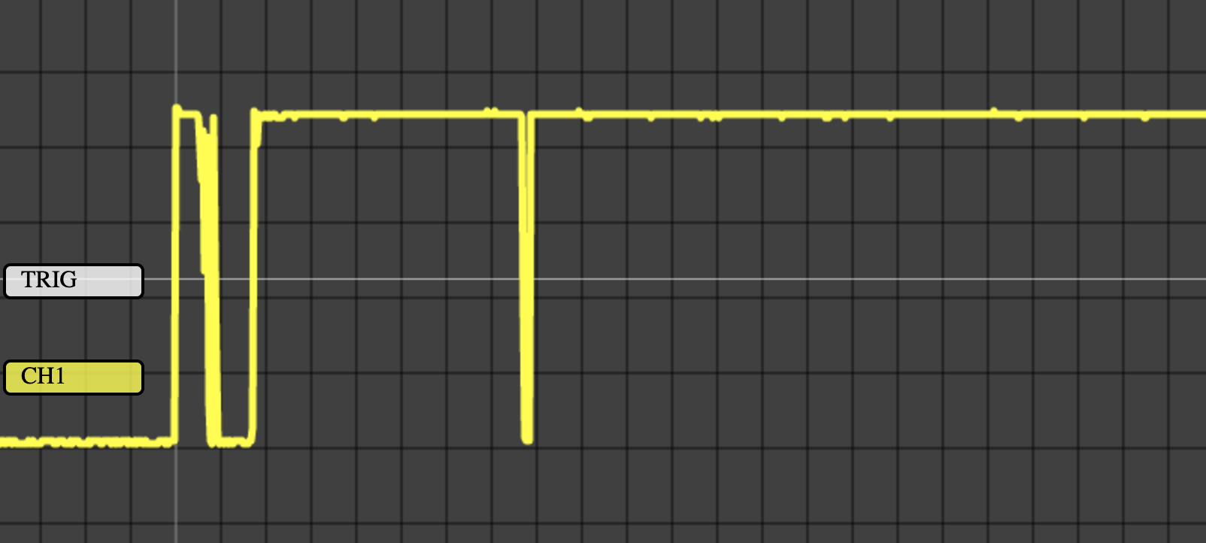
Experiment – sietova kapacitna vazba

Slide 14
Pull down
10k

Slide 15
Pull up
10k

Slide 17
Uloha 3: Softwarovy pull-up

Slide 18
Uloha 4: Detekovat stlacenie a rozopnutie

Slide 19
Experiment – prechodovy jav

Slide 20
Uloha 5: Detekovat stlacenie a rozpnutie – debouncing
Uloha 6: Prepinat internu led v okamihu stlacenia tlacidla

Slide 21
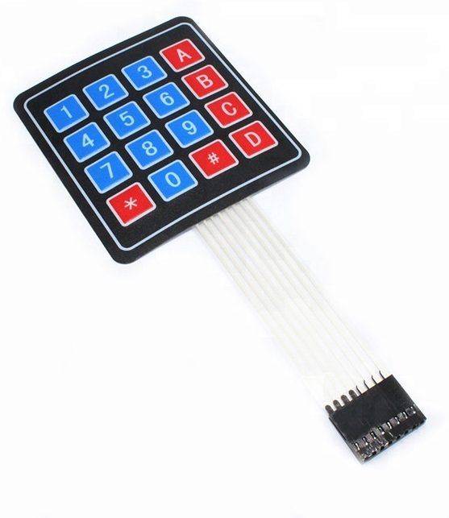
Maticova klavesnica

Slide 22
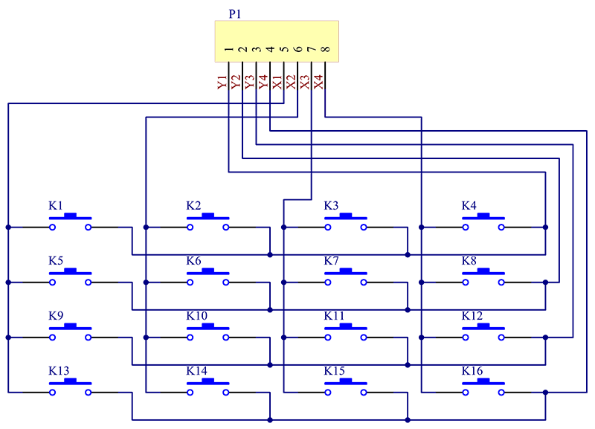
Maticova klavesnica – zapojenie

Slide 23
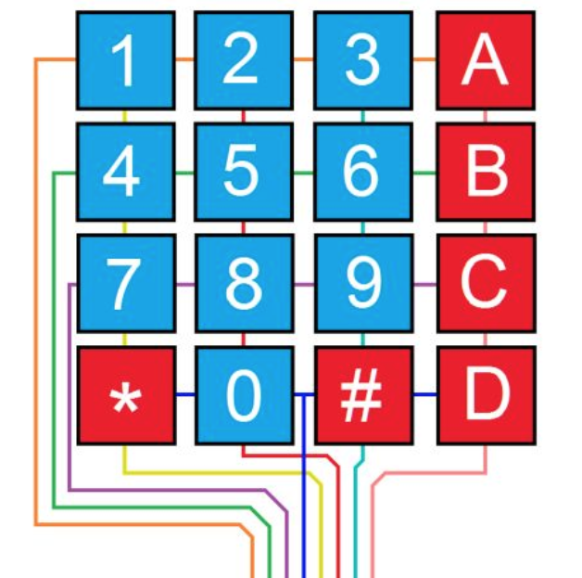
Maticova klavesnica

Slide 24
Uloha 7: Rozsvietit internu led ked je stlacena cislica “1”
(piny 5 a 9)

Slide 25
Uloha 8: Detekovat stlacenie v prvom riadku

Slide 26
Uloha 9: Detekovat vsetky klavesy

Slide 27
Ukazka 10: Klavesnica – fantomove klavesy

Slide 28
Uloha 11: Dvojznakovy kodovy zamok

Slide 29
Uloha 12: Klavesnica – stvorznakovy kodovy zamok

Slide 30
Dakujem!
Ing. Gabriel Valky, PhD.

